Slide 1
TETOUAN CITY POWER USAGE
A Machine Learning Opportunity
Hoang Le Duc, Raynard Flores, Bryan Frank, Alex Lopez and Josean Maldonado

Slide 2
Project Overview
Machine Learning Problem
The machine learning problem presented is to predict power consumption in different zones of Tetouan City based on various features.
Objective
This project aimed to utilize skills from Machine Learning lessons and labs in Python to develop an optimal model for predicting power flows. The prediction was based on variables such as weather conditions, month, day of the week, and time of day.

Slide 3
01
DATA SELECTION
AND PREPARATION
Alex

Slide 4
Data Selection & Prep
Found Power Consumption Dataset from UC Irvine Machine Learning Repository:
https://archive.ics.uci.edu/dataset/849/power+consumption+of+tetouan+city
Cleaning Steps:
Formatted Datetime column to datetime object
Extracted Time of day, Week day, and Month from datetime
Binned time of day into : Morning, Afternoon, Evening, and Night
Converted Temperature from °C to °F
Reorganized columns for correlation triangle-heat map.

Slide 5
02
FEATURE ENGINEERING
AND PREPARATION

Slide 6
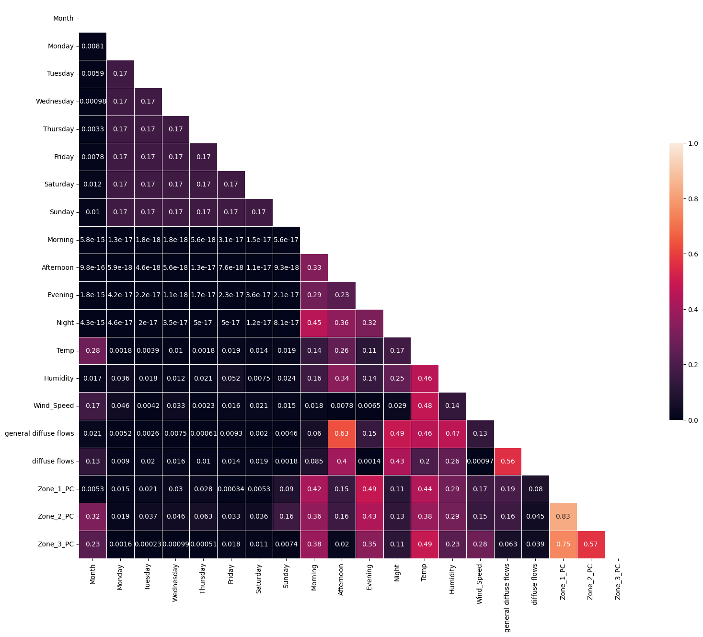
Feature Engineering/Selection
One Hot Encoded Time of Day, Days of Week
Min-Max Scaler for Data Scaling, including month (as number)
Triangle Correlation Heatmap to evaluate feature correlation:
Found no features highly correlated with each other
Didn’t Drop any features overall; we kept them all

Slide 7
03
MACHINE LEARNING MODELS
Bryan

Slide 8
EVALUATION METRICS
r²
How accurate a model is.
RMSE
Measures how big or small a models mistakes are.
MAE
More understandable measure of how far off a model is.
K-fold Cross Validation
Shuffles subsets to get multiple samples of a model.
Notes:
R² - how accurate our model is
RMSE - Root of Mean of Squared Errors - take all the differences between actual and predicted, sum them up, square them, divide them by the number of observations, get the square root of that. Pretty complicated measure of how far off our model’s predictions are from the actual observed values.
MAE - Mean of Absolute value of Errors - gets the sum of the absolute values of all differences between predicted and actual outcomes and takes the average of that - Tells us how far off our models of kWH usage was
K-fold Cross Validation - subsets data to create multiple subgroups (in our case 5, which was the default) to test each of those individually and compare the results - gives us a better idea of how well our model functions.

Slide 9
MODEL EVALUATION
0.91
Random Forest
AdaBoost
0.97
MAE: 1163 kWh
MAE: 835 kWh
0.92
XGBoost
Gradient Boost
0.90
MAE: 1085 kWh
MAE: 1181 kWh
Notes:
We ran all the tests we were taught. 50/50 on results. Best ones here.
R2 scores in boxes
MAE details underneath
AdaBoost best by far - roughly .97 r², MAE of only 835 kWh - less than 5% of 20,000 kWh max. Other models were sitting at about 90% accuracy, 5% error, AdaBoost just did better

Slide 10
04
Hyperparameter Tuning
& Model Optimization
Hoang

Slide 11
Overall, the accuracy of the AdaBoost Model was sufficient
And thus we focused more on Cross-validation in order to measure the performance between our models and shows more realistic performance metrics
Metrics focused: MAE and R2

Slide 12
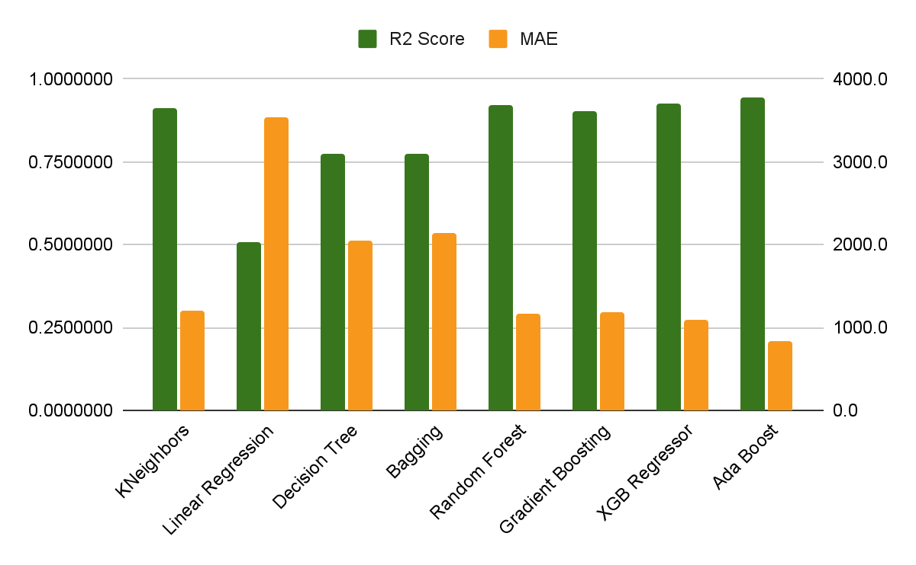
Comparison of Models Performance

Slide 13
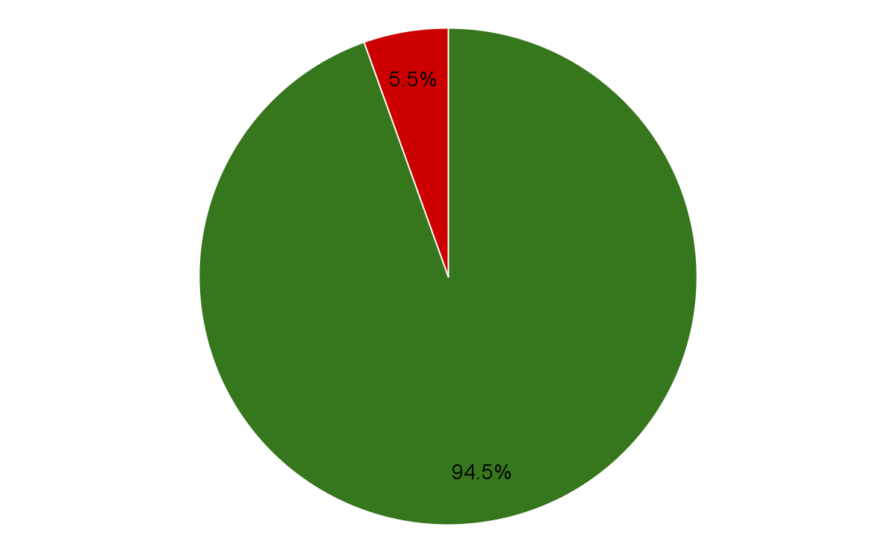
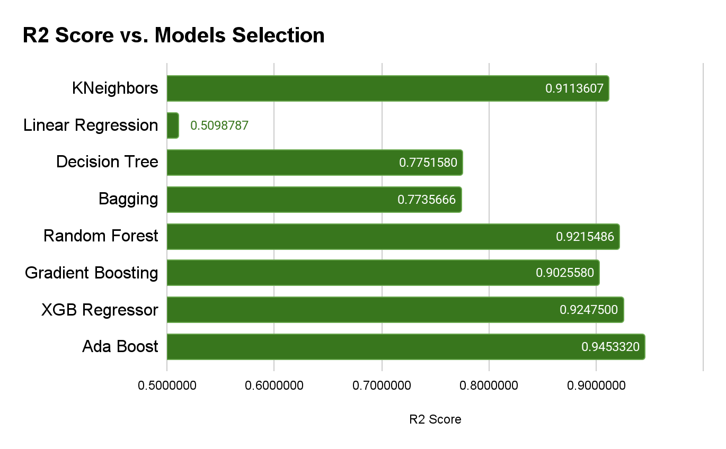
Comparison of Models Performance
94.5%
Correct
Not Correct
94.5% chance for the prediction to be corrected
In Incorrect Cases, average absolute difference is ~835.62 KwH from actual data
AdaBoostRegressor using DecisionTreeRegressor returns the best cross-validated R2 (0.945332) and MAE (835.620447)

Slide 14
05
Insights
Raynard and Josean

Slide 15
REAL WORLD APPLICATION
IMPLEMENTING WEATHER FORECASTING
RESOLVING POWER ISSUES
Use weather forecasting to more accurately predict and prepare for power demands
Identify times and days where power issues are most prevalent
Adapt distribution methods and policies to reduce shortages and maintain more consistent flow

Slide 16
CHALLENGES & LEARNINGS
CHALLENGES
LEARNINGS
Collaborating in Visual Studio Code using LiveShare.
Using it with a group of five caused crashes and lost progress.
This significantly delayed our data cleaning process.
Test collaboration tools with larger groups beforehand.
Regularly save work to prevent data loss.
Have a backup plan—and maybe a quantum computer to run LiveShare!

Slide 17
FUTURE WORK AND IMPROVEMENTS
Expand Dataset
Incorporate More Features
Add details about cities and regions, such as commercial vs residential areas and population density.
Include data on industrial activity, seasonal events, and holidays.
Cross-Regional Comparisons
Advance Models
Compare power consumption patterns across different regions or countries to identify common factors and unique challenges.
Experiment with more advanced machine learning models and techniques, such as deep learning or ensemble methods, to improve prediction accuracy.

Slide 18
THANKS!
Do you have any questions?
Please keep this slide for attribution

